Slide 1
CSE 311: Foundations of Computing
Lecture 9: Proof Strategies & Set Theory

Slide 2
Even and Odd
Predicate Definitions
Even(x) ≡ $∃y \left(x=2y\right)$
Odd(x) ≡ $∃y (x=2y+1)$
Domain of Discourse
Integers
Prove “The sum of two odd numbers is even.”
Formally, prove ∀x ∀y ((Odd(x) ∧ Odd(y))→Even(x+y))

Slide 3
Even and Odd
Predicate Definitions
Even(x) ≡ $∃y \left(x=2y\right)$
Odd(x) ≡ $∃y (x=2y+1)$
Domain of Discourse
Integers
Prove “The sum of two odd numbers is even.”
Formally, prove ∀x ∀y ((Odd(x) ∧ Odd(y))→Even(x+y))
Let x and y be arbitrary integers.
Since x and y were arbitrary, the sum of any odd integers is even.
Let x be an arbitrary integer
Let y be an arbitrary integer
3. (Odd(x) ∧ Odd(y)) → Even(x+y)
4. ∀x ∀y ((Odd(x) ∧ Odd(y)) → Even(x+y)) Intro ∀

Slide 4
Even and Odd
Predicate Definitions
Even(x) ≡ $∃y \left(x=2y\right)$
Odd(x) ≡ $∃y (x=2y+1)$
Domain of Discourse
Integers
Prove “The sum of two odd numbers is even.”
Formally, prove ∀x ∀y ((Odd(x) ∧ Odd(y))→Even(x+y))
Let x and y be arbitrary integers.
Suppose that both are odd.
so x+y is even.
Since x and y were arbitrary, the sum of any odd integers is even.
Let x be an arbitrary integer
Let y be an arbitrary integer
3.1 Odd(x) ∧ Odd(y) Assumption
3.9 Even(x+y)
3. (Odd(x) ∧ Odd(y)) → Even(x+y) DPR
4. ∀x ∀y ((Odd(x) ∧ Odd(y)) → Even(x+y)) Intro ∀

Slide 5
Even and Odd
Predicate Definitions
Even(x) ≡ $∃y \left(x=2y\right)$
Odd(x) ≡ $∃y (x=2y+1)$
Domain of Discourse
Integers
Prove “The sum of two odd numbers is even.”
Formally, prove ∀x ∀y ((Odd(x) ∧ Odd(y))→Even(x+y))
Let x and y be arbitrary integers.
Suppose that both are odd.
so x+y is even.
Since x and y were arbitrary, the sum of any odd integers is even.
Let x be an arbitrary integer
Let y be an arbitrary integer
3.1 Odd(x) ∧ Odd(y) Assumption
3.2 Odd(x) Elim ∧: 2.1
3.3 Odd(y) Elim ∧: 2.1
3.9 Even(x+y)
3. (Odd(x) ∧ Odd(y)) → Even(x+y) DPR
4. ∀x ∀y ((Odd(x) ∧ Odd(y)) → Even(x+y)) Intro ∀

Slide 6
English Proof: Even and Odd
Even(x) ≡ ∃y (x=2y)
Odd(x) ≡ ∃y (x=2y+1)
Domain: Integers
Prove “The sum of two odd numbers is even.”
Let x and y be arbitrary integers.
Suppose that both are odd.
Then, we have x = 2a+1 for some integer a and y = 2b+1 for some integer b.
so x+y is, by definition, even.
Since x and y were arbitrary, the sum of any odd integers is even.
Let x be an arbitrary integer
Let y be an arbitrary integer
3.1 Odd(x) ∧ Odd(y) Assumption
3.2 Odd(x) Elim ∧: 2.1
3.3 Odd(y) Elim ∧: 2.1
3.4 $∃$z (x = 2z+1) Def of Odd: 2.2
3.5 x = 2a+1 Elim ∃: 2.4
3.6 $∃$z (y = 2z+1) Def of Odd: 2.3
3.7 y = 2b+1 Elim ∃: 2.5
3.9$∃$z (x+y = 2z) Intro ∃: 2.4
3.10 Even(x+y) Def of Even
3. (Odd(x) ∧ Odd(y)) → Even(x+y) DPR
4. ∀x ∀y ((Odd(x) ∧ Odd(y)) → Even(x+y)) Intro ∀
Notes:
We skip lines stating “there exists” and just immediately name that object.
We skip lines stating implication proven by direct proof rule.

Slide 7
English Proof: Even and Odd
Even(x) ≡ ∃y (x=2y)
Odd(x) ≡ ∃y (x=2y+1)
Domain: Integers
Prove “The sum of two odd numbers is even.”
Let x and y be arbitrary integers.
Suppose that both are odd.
Then, we have x = 2a+1 for some integer a and y = 2b+1 for some integer b.
Their sum is x+y = ... = 2(a+b+1)
so x+y is, by definition, even.
Since x and y were arbitrary, the sum of any odd integers is even.
Let x be an arbitrary integer
Let y be an arbitrary integer
3.1 Odd(x) ∧ Odd(y) Assumption
3.2 Odd(x) Elim ∧: 2.1
3.3 Odd(y) Elim ∧: 2.1
3.4 $∃$z (x = 2z+1) Def of Odd: 2.2
3.5 x = 2a+1 Elim ∃: 2.4
3.6 $∃$z (y = 2z+1) Def of Odd: 2.3
3.7 y = 2b+1 Elim ∃: 2.5
3.8 x+y = 2(a+b+1) Algebra
3.9$∃$z (x+y = 2z) Intro ∃: 2.4
3.10 Even(x+y) Def of Even
3. (Odd(x) ∧ Odd(y)) → Even(x+y) DPR
4. ∀x ∀y ((Odd(x) ∧ Odd(y)) → Even(x+y)) Intro ∀
Notes:
We skip lines stating “there exists” and just immediately name that object.
We skip lines stating implication proven by direct proof rule.

Slide 8
Even and Odd
Predicate Definitions
Even(x) ≡ $∃y \left(x=2y\right)$
Odd(x) ≡ $∃y (x=2y+1)$
Domain of Discourse
Integers
Prove “The sum of two odd numbers is even.”
Proof: Let x and y be arbitrary integers.
Suppose that both are odd. Then, we have x = 2a+1 for some integer a and y = 2b+1 for some integer b. Their sum is x+y = (2a+1) + (2b+1) = 2a+2b+2 = 2(a+b+1), so x+y is, by definition, even.
Since x and y were arbitrary, the sum of any two odd integers is even.

Slide 9
Even and Odd
Predicate Definitions
Even(x) ≡ $∃y \left(x=2y\right)$
Odd(x) ≡ $∃y (x=2y+1)$
Domain of Discourse
Integers
Prove “The sum of two odd numbers is even.”
Proof: Let x and y be arbitrary odd integers.
Then, x = 2a+1 for some integer a and y = 2b+1 for some integer b. Their sum is x+y = (2a+1) + (2b+1) = 2a+2b+2 = 2(a+b+1), so x+y is, by definition, even.
Since x and y were arbitrary, the sum of any two odd integers is even.
∀x ∀y ((Odd(x) ∧ Odd(y))→Even(x+y))

Slide 10
Rational Numbers
Domain of Discourse
Real Numbers
A real number x is rational iff there exist integers a and b with b≠0 such that x=a/b.
Rational(x) := ∃a ∃b (((Integer(a) ∧ Integer(b)) ∧ (x=a/b)) ∧ b≠0)

Slide 11
Rationality
Domain of Discourse
Real Numbers
Predicate Definitions
Rational(x) := $∃a ∃b (Integer\left(a\right)∧Integer\left(b\right)∧\left(x=a/b\right)∧\left(b≠0\right))$
Prove: “The product of two rationals is rational.”
Formally, prove ∀x ∀y ((Rational(x) ∧ Rational(y)) → Rational(xy))
Notes:
Note: this is just an implication, with x and y as constants.

Slide 12
Rationality
Domain of Discourse
Real Numbers
Predicate Definitions
Rational(x) := $∃a ∃b (Integer\left(a\right)∧Integer\left(b\right)∧\left(x=a/b\right)∧\left(b≠0\right))$
Prove: “The product of two rationals is rational.”
Proof: Let x and y be arbitrary reals.
Suppose x and y are rational.
Thus, xy is rational.
Since x and y were arbitrary, we have shown that the product of any two rationals is rational.
Notes:
English proofs will often skip the first and last parts since they are boilerplate.

Slide 13
Rationality
Domain of Discourse
Real Numbers
Predicate Definitions
Rational(x) := $∃a ∃b (Integer\left(a\right)∧Integer\left(b\right)∧\left(x=a/b\right)∧\left(b≠0\right))$
Prove: “The product of two rationals is rational.”
Proof: Let x and y be arbitrary rationals.
Thus, xy is rational.
Since x and y were arbitrary, we have shown that the product of any two rationals is rational.
Notes:
English proofs will often skip the first and last parts since they are boilerplate.

Slide 14
Rationality
Domain of Discourse
Real Numbers
Predicate Definitions
Rational(x) := $∃a ∃b (Integer\left(a\right)∧Integer\left(b\right)∧\left(x=a/b\right)∧\left(b≠0\right))$
Prove: “The product of two rationals is rational.”
Proof: Let x and y be arbitrary rationals.
Then, x = a/b for some integers a, b, where b≠0, and y = c/d for some integers c,d, where d≠0.
Thus, xy is rational.
Since x and y were arbitrary, we have shown that the product of any two rationals is rational.
Notes:
English proofs will often skip the first and last parts since they are boilerplate.

Slide 15
Rationality
Domain of Discourse
Real Numbers
Predicate Definitions
Rational(x) := $∃a ∃b (Integer\left(a\right)∧Integer\left(b\right)∧\left(x=a/b\right)∧\left(b≠0\right))$
Prove: “The product of two rationals is rational.”
Proof: Let x and y be arbitrary rationals.
Then, x = a/b for some integers a, b, where b≠0, and y = c/d for some integers c,d, where d≠0.
By definition, then, xy is rational.
Since x and y were arbitrary, we have shown that the product of any two rationals is rational.
Notes:
English proofs will often skip the first and last parts since they are boilerplate.

Slide 16
Rationality
Domain of Discourse
Real Numbers
Predicate Definitions
Rational(x) := $∃a ∃b (Integer\left(a\right)∧Integer\left(b\right)∧\left(x=a/b\right)∧\left(b≠0\right))$
Prove: “The product of two rationals is rational.”
Proof: Let x and y be arbitrary rationals.
Then, x = a/b for some integers a, b, where b≠0, and y = c/d for some integers c,d, where d≠0.
Multiplying, we get that xy = (a/b)(c/d) = (ac)/(bd). Since b and d are both non-zero, so is bd. Furthermore, ac and bd are integers. By definition, then, xy is rational.
Since x and y were arbitrary, we have shown that the product of any two rationals is rational.
Notes:
English proofs will often skip the first and last parts since they are boilerplate.

Slide 17
Rationality
Domain of Discourse
Real Numbers
Predicate Definitions
Rational(x) := $∃a ∃b (Integer\left(a\right)∧Integer\left(b\right)∧\left(x=a/b\right)∧\left(b≠0\right))$
Prove: “The product of two rationals is rational.”
OR “If x and y are rational, then xy is rational.”
Recall that unquantified variables (not constants) are implicitly for-all quantified.
∀x ∀y ((Rational(x) ∧ Rational(y)) → Rational(xy))
Notes:
Note: this is just an implication, with x and y as constants.

Slide 18
Rationality
Domain of Discourse
Real Numbers
Predicate Definitions
Rational(x) := $∃a ∃b (Integer\left(a\right)∧Integer\left(b\right)∧\left(x=a/b\right)∧\left(b≠0\right))$
Prove: “If x and y are rational, then xy is rational.”
Proof: Let x and y be arbitrary rationals. Suppose x and y are rational.
Then, x = a/b for some integers a, b, where b≠0, and y = c/d for some integers c,d, where d≠0.
Multiplying, we get that xy = (a/b)(c/d) = (ac)/(bd). Since b and d are both non-zero, so is bd. Furthermore, ac and bd are integers. By definition, then, xy is rational.
Since x and y were arbitrary, we have shown that the product of any two rationals is rational.
Notes:
English proofs will often skip the first and last parts since they are boilerplate.

Slide 19
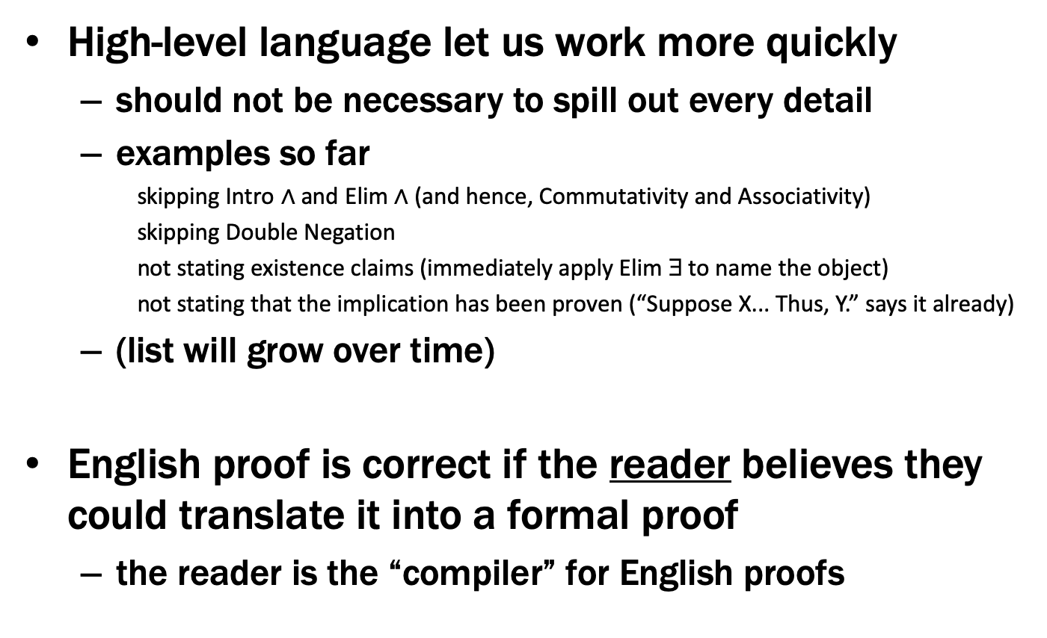
Last class: English Proofs
High-level language let us work more quickly
should not be necessary to spill out every detail
examples so far
skipping Intro $∧$ and Elim $∧$ (and hence, Commutativity and Associativity)
skipping Double Negation
not stating existence claims (immediately apply Elim ∃ to name the object)
not stating that the implication has been proven (“Suppose X... Thus, Y.” says it already)
(list will grow over time)
English proof is correct if the reader believes they could translate it into a formal proof
the reader is the “compiler” for English proofs

Slide 20
Proof Strategies

Slide 21
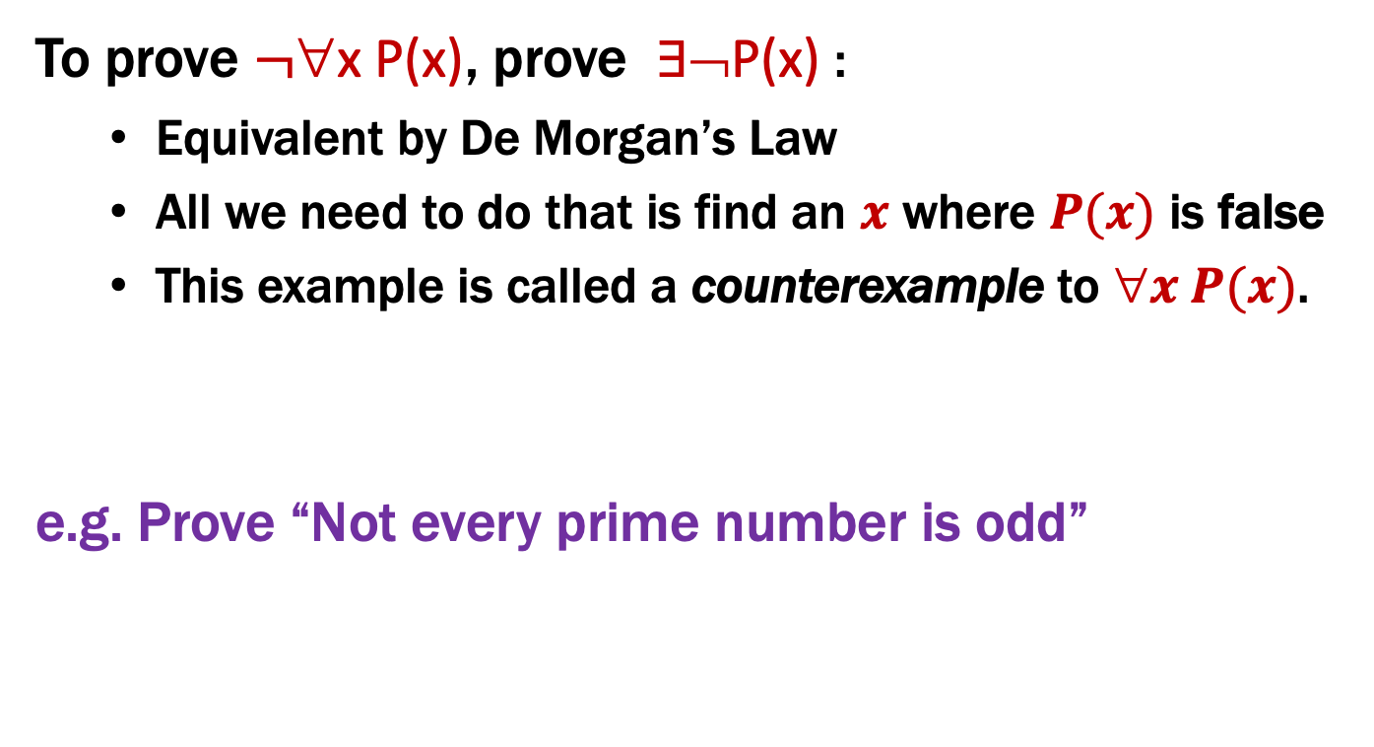
Proof Strategies: Counterexamples
To prove $¬$∀x P(x), prove ∃¬P(x) :
Equivalent by De Morgan’s Law
All we need to do that is find an $x$ where $P(x)$ is false
This example is called a counterexample to $x P(x)$.
e.g. Prove “Not every prime number is odd”
Proof: 2 is a prime that is not odd — a counterexample to the claim that every prime number is odd.
An English proof does not need to cite De Morgan’s law.

Slide 22
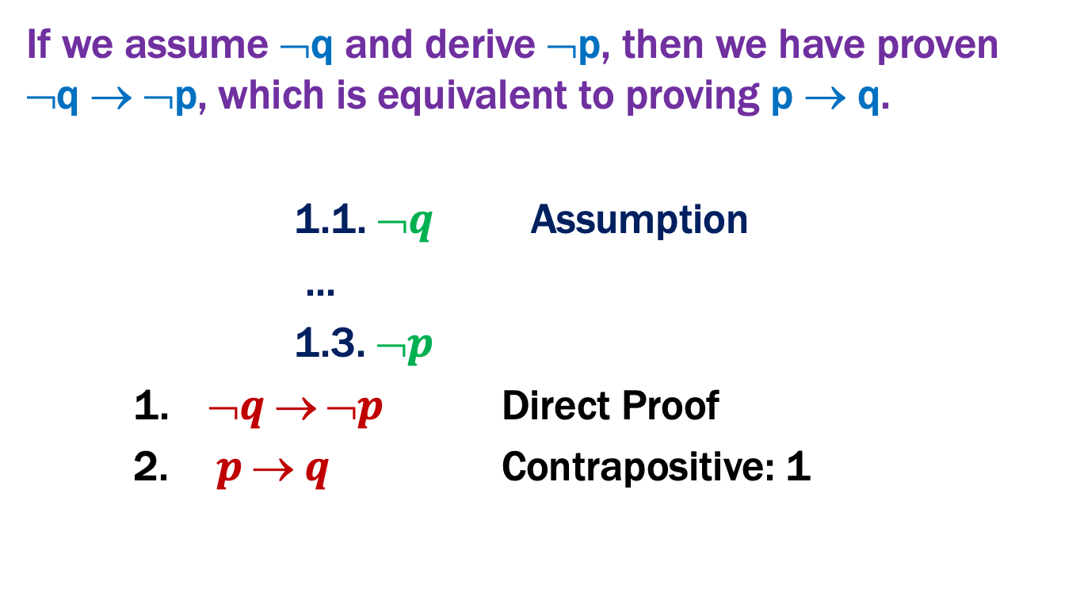
Proof Strategies: Proof by Contrapositive
If we assume ¬q and derive ¬p, then we have proven ¬q → ¬p, which is equivalent to proving p → q.
1.1. $➢q$ Assumption
...
1.3. $➢p$
1. $➢q  ➢p$ Direct Proof
2.$p  q$ Contrapositive: 1
Notes:
English proof would start “We will prove the contrapositive. Suppose not q ... Thus, not p.”

Slide 23
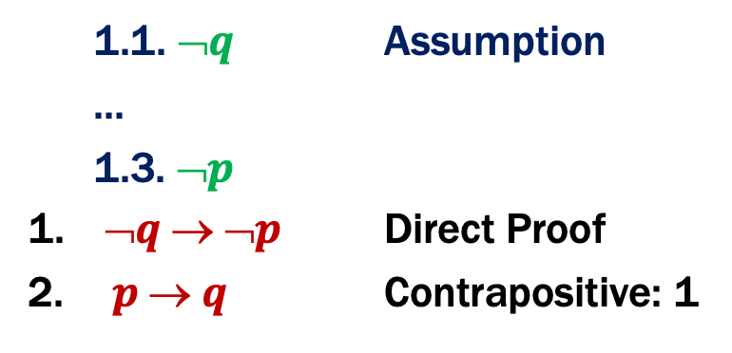
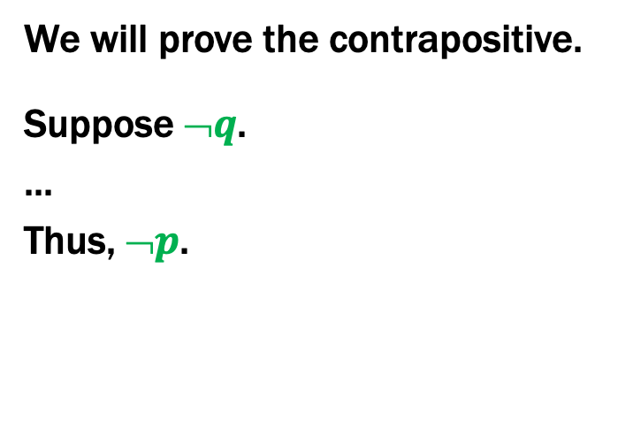
Proof Strategies: Proof by Contrapositive
If we assume ¬q and derive ¬p, then we have proven ¬q → ¬p, which is equivalent to proving p → q.
We will prove the contrapositive.
Suppose $➢q$.
...
Thus, $➢p$.
1.1. $➢q$ Assumption
...
1.3. $➢p$
1. $➢q  ➢p$ Direct Proof
2.$p  q$ Contrapositive: 1
Notes:
Nothing at the end.

Slide 24
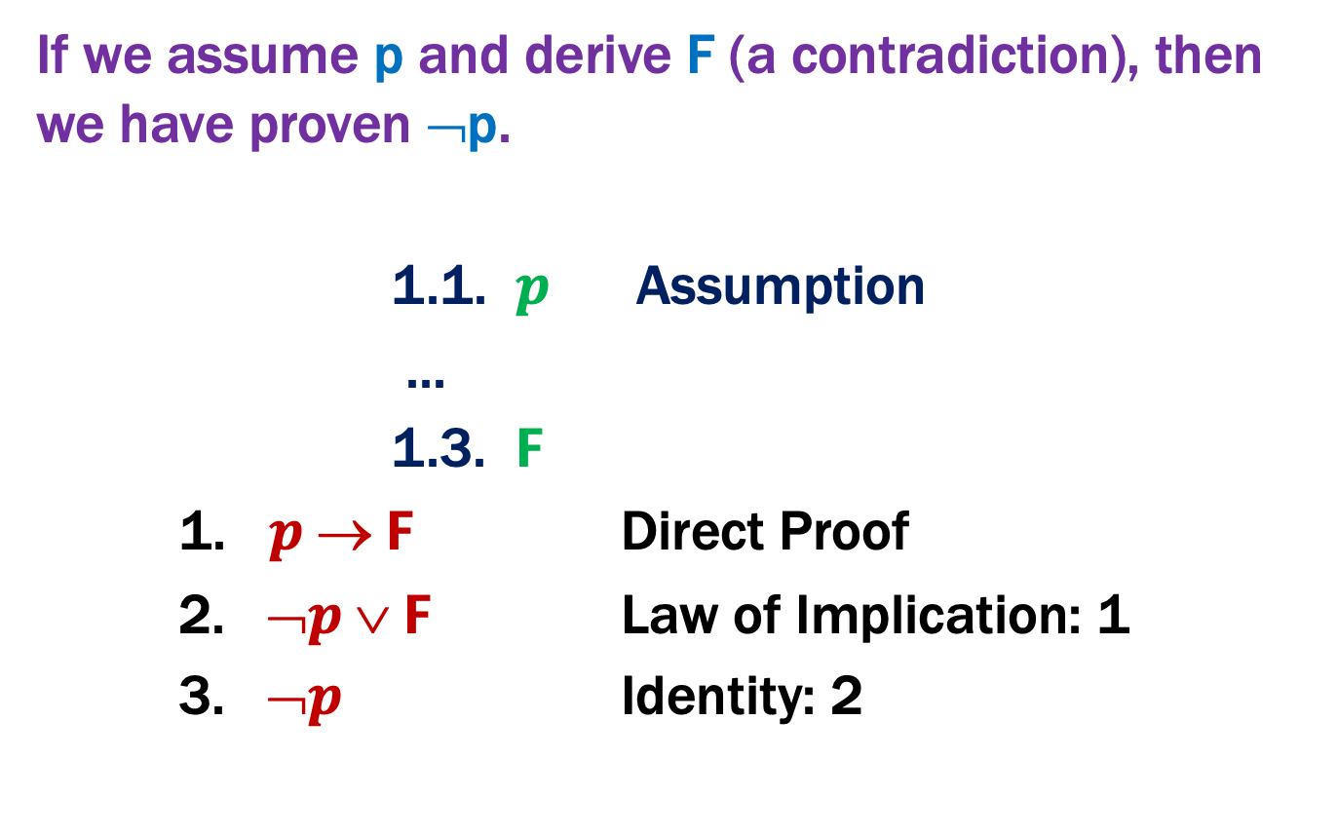
Proof by Contradiction: One way to prove ¬p
If we assume p and derive F (a contradiction), then we have proven ¬p.
1.1. $p$ Assumption
...
1.3. $F$
1. $p  F$ Direct Proof
2. $➢p  F$ Law of Implication: 1
3. $➢p$ Identity: 2
Notes:
English proof would start: “We will prove this by contradiction. ... F, which is a contradiction.”

Slide 25
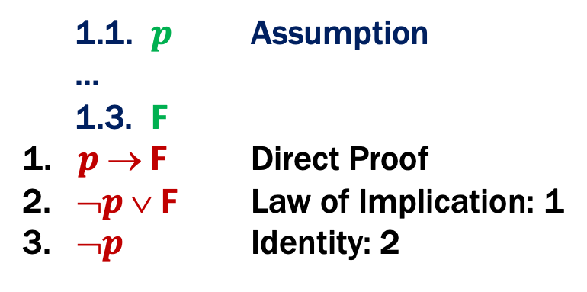
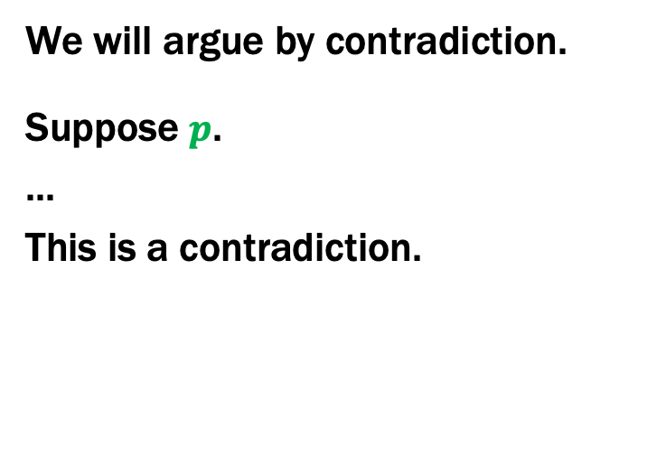
Proof Strategies: Proof by Contradiction
If we assume p and derive F (a contradiction), then we have proven ¬p.
We will argue by contradiction.
Suppose $p$.
...
This is a contradiction.
1.1. $p$ Assumption
...
1.3. $F$
1. $p  F$ Direct Proof
2. $➢p  F$ Law of Implication: 1
3. $➢p$ Identity: 2
Often, we will infer ¬R, where R is a prior fact. Putting these together, we have R ∧ ¬R ≡ F
Notes:
Nothing at the end.

Slide 26
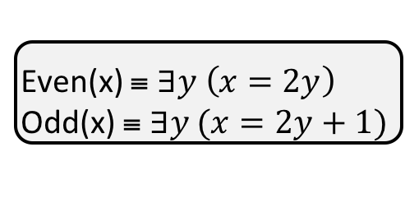
Even and Odd
Predicate Definitions
Even(x) ≡ $∃y \left(x=2y\right)$
Odd(x) ≡ $∃y (x=2y+1)$
Domain of Discourse
Rationals
Prove: “No integer is both even and odd.”
Formally, prove ¬ ∃x (Even(x)∧Odd(x))
Proof: We will argue by contradiction.

Slide 27
Even and Odd
Predicate Definitions
Even(x) ≡ $∃y \left(x=2y\right)$
Odd(x) ≡ $∃y (x=2y+1)$
Domain of Discourse
Rationals
Prove: “No integer is both even and odd.”
Formally, prove ¬ ∃x (Even(x)∧Odd(x))
Proof: We will argue by contradiction.
Suppose that x is an integer that is both even and odd.
This is a contradiction.

Slide 28
Even and Odd
Predicate Definitions
Even(x) ≡ $∃y \left(x=2y\right)$
Odd(x) ≡ $∃y (x=2y+1)$
Domain of Discourse
Rationals
Prove: “No integer is both even and odd.”
Formally, prove ¬ ∃x (Even(x)∧Odd(x))
Proof: We will argue by contradiction.
Suppose that x is an integer that is both even and odd. Then, x=2a for some integer a, and x=2b+1 for some integer b.
This is a contradiction.

Slide 29
Even and Odd
Predicate Definitions
Even(x) ≡ $∃y \left(x=2y\right)$
Odd(x) ≡ $∃y (x=2y+1)$
Domain of Discourse
Rationals
Prove: “No integer is both even and odd.”
Formally, prove ¬ ∃x (Even(x)∧Odd(x))
Proof: We will argue by contradiction.
Suppose that x is an integer that is both even and odd. Then, x=2a for some integer a, and x=2b+1 for some integer b. This means 2a=x=2b+1 and hence 2a-2b=1 and so a-b=½. But a-b is an integer while ½ is not, so they cannot be equal. This is a contradiction.
Formally, we’ve shown Integer(½) ∧ ¬Integer(½) ≡ F.

Slide 30
Strategies
Simple proof strategies already do a lot
counter examples
proof by contrapositive
proof by contradiction
Later we will cover a specific strategy that applies to loops and recursion (mathematical induction)

Slide 31
Applications of Predicate Logic
Remainder of the course will use predicate logic to prove important properties of interesting objects
start with math objects that are widely used in CS
eventually more CS-specific objects
Encode domain knowledge in predicate definitions
Then apply predicate logic to infer useful results
Domain of Discourse
Predicate Definitions
Integers
Even(x) ≡ ∃y (x = 2⋅y)
Odd(x) ≡ ∃y (x = 2⋅y + 1)

Slide 32
Number Theory

Slide 33
Number Theory (and applications to computing)
Branch of Mathematics with direct relevance to computing
Many significant applications
Cryptography & Security
Data Structures
Distributed Systems
Important toolkit

Slide 34
Modular Arithmetic
Arithmetic over a finite domain
Almost all computation is over a finite domain

Slide 35
I’m ALIVE!
public class Test {
final static int SEC_IN_YEAR = 364*24*60*60*100;
public static void main(String args[]) {
System.out.println(
“I will be alive for at least ” +
SEC_IN_YEAR * 101 + “ seconds.”
);
}
}
[-128, 127]
14
-116

Slide 36
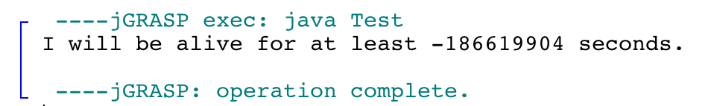
I’m ALIVE!
public class Test {
final static int SEC_IN_YEAR = 364*24*60*60*100;
public static void main(String args[]) {
System.out.println(
“I will be alive for at least ” +
SEC_IN_YEAR * 101 + “ seconds.”
);
}
}
[-128, 127]
Prints : “I will be alive for at least -186619904 seconds.”
14
-116

Slide 37
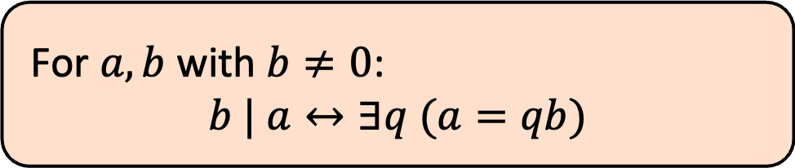
Divisibility
Domain of Discourse
Integers
Definition: “b divides a”
For $a,b$ with $b≠0$:
$$b | a↔∃q (a=qb)$$
Check Your Understanding. Which of the following are true?
5 | 1 25 | 5 5 | 0 3 | 2
1 | 5 5 | 25 0 | 5 2 | 3

Slide 38
Divisibility
Domain of Discourse
Integers
Definition: “b divides a”
For $a,b$ with $b≠0$:
$$b | a↔∃q (a=qb)$$
Check Your Understanding. Which of the following are true?
5 | 1 25 | 5 5 | 0 3 | 2
1 | 5 5 | 25 0 | 5 2 | 3
5 | 1 iff 1 = 5k
25 | 5 iff 5 = 25k
5 | 0 iff 0 = 5k
3 | 2 iff 2 = 3k
1 | 5 iff 5 = 1k
5 | 25 iff 25 = 5k
0 | 5 iff 5 = 0k
2 | 3 iff 3 = 2k

Slide 39
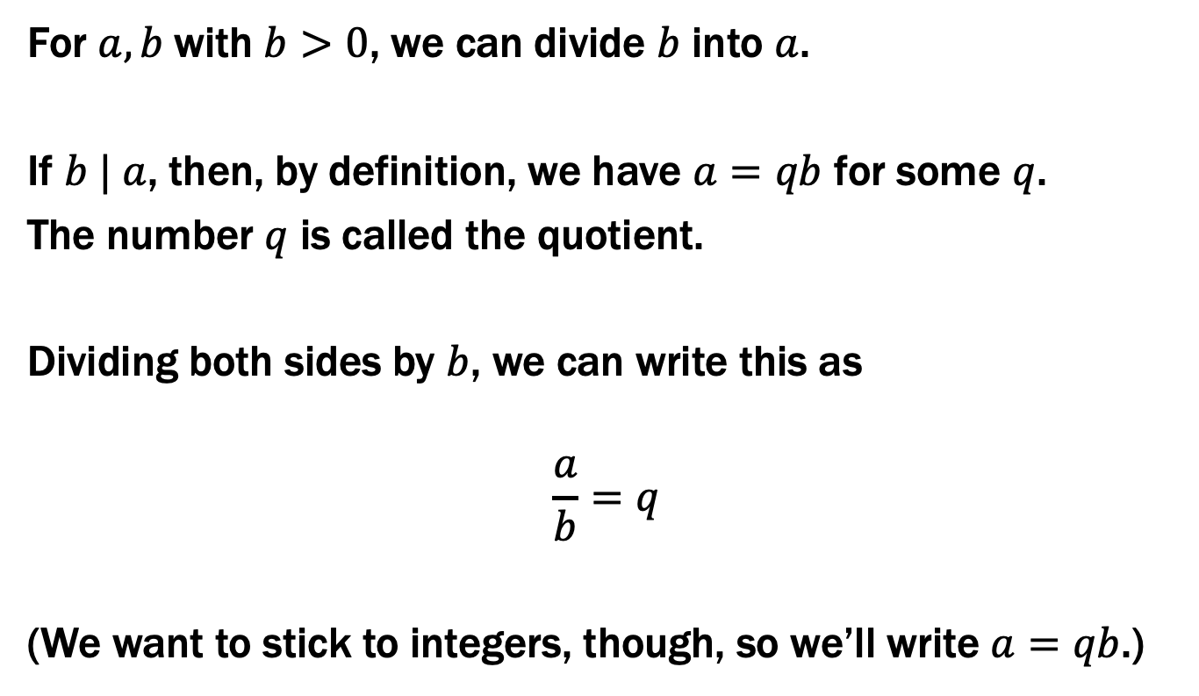
Recall: Elementary School Division
For $a,b$with $b>0$, we can divide $b$ into $a$.
If $b | a$, then, by definition, we have $a=qb$ for some $q$.
The number $q$ is called the quotient.
Dividing both sides by $b$, we can write this as
$$\frac{a}{b}=q$$
(We want to stick to integers, though, so we’ll write $a=qb$.)

Slide 40
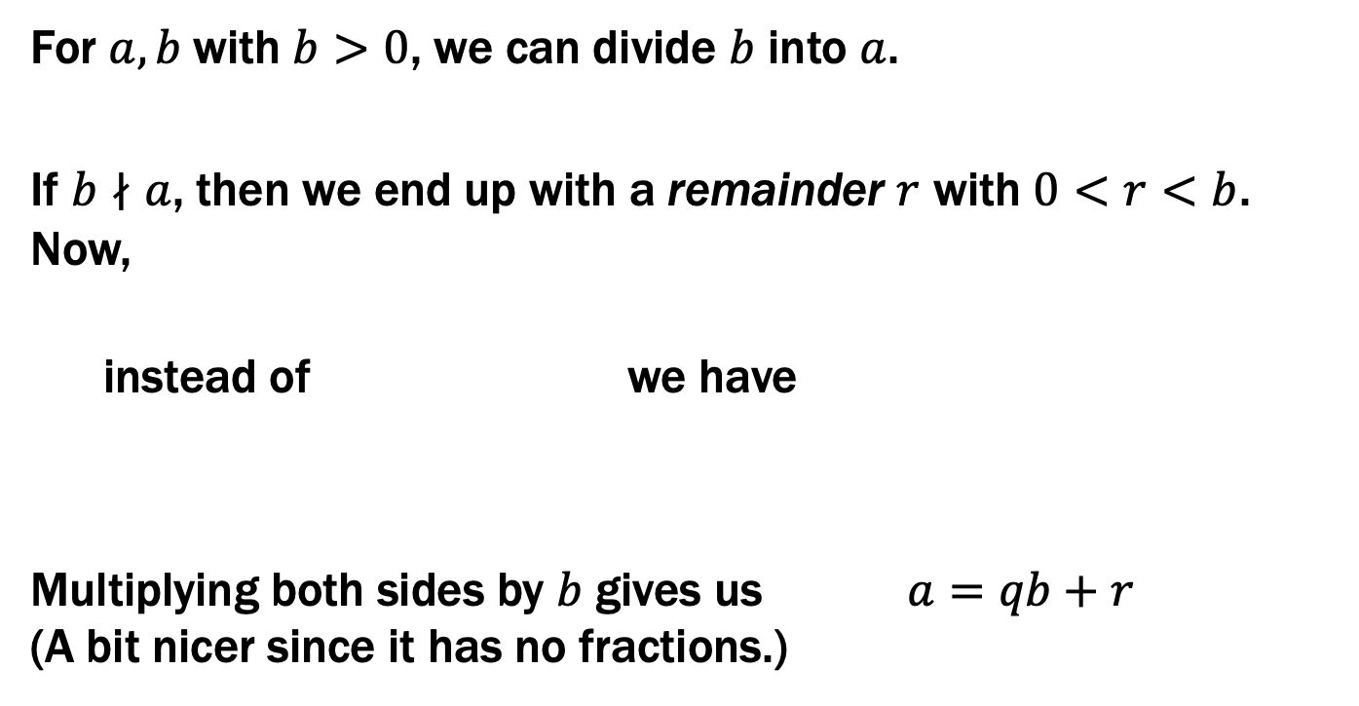
Recall: Elementary School Division
For $a,b$with $b>0$, we can divide $b$ into $a$.
If $b∤a$, then we end up with a remainder $r$ with $0<r<b$. Now,
instead of we have
Multiplying both sides by $b$ gives us $a=qb+r$ (A bit nicer since it has no fractions.)
$$\frac{a}{b}=q$$
$$\frac{a}{b}=q+\frac{r}{b}$$

Slide 41
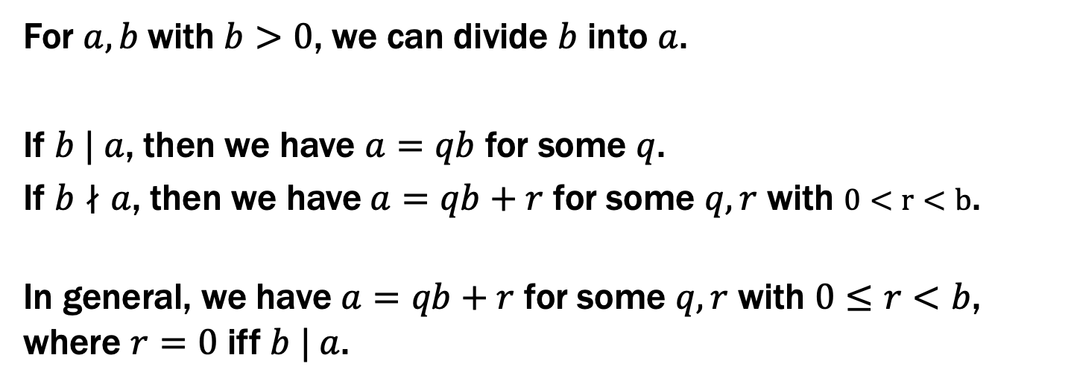
Recall: Elementary School Division
For $a,b$with $b>0$, we can divide $b$ into $a$.
If $b | a$, then we have $a=qb$ for some $q$.
If $b∤a$, then we have $a=qb+r$ for some $q,r$ with $0<r<b$.
In general, we have $a=qb+r$ for some $q,r$ with $0≤r<b$, where $r=0$ iff $b | a$.

Slide 42
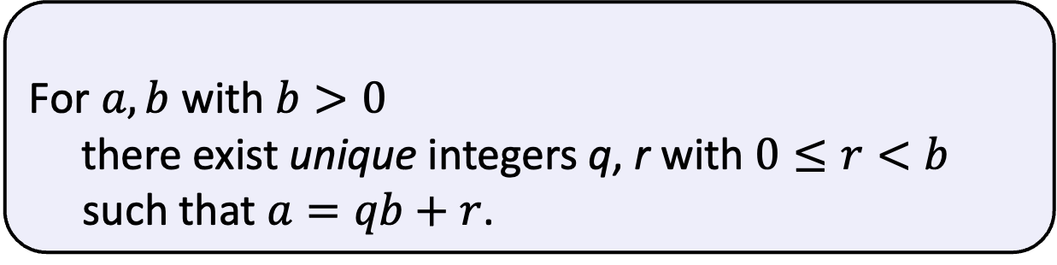
Division Theorem
Domain of Discourse
Integers
Division Theorem
For $a,b$ with $b>0$
there exist unique integers q, r with $0≤r<b$ such that $a=qb+r$.
To put it another way, if we divide b into a, we get a unique quotient and non-negative remainder
q = a div b
r = a mod b
Note: r ≥ 0 even if a < 0.
Not quite the same as a % d.

Slide 43
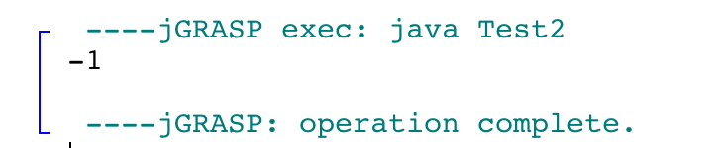
Division Theorem
Domain of Discourse
Integers
Division Theorem
For $a,b$ with $b>0$
there exist unique integers q, r with $0≤r<b$ such that $a=qb+r$.
To put it another way, if we divide b into a, we get a unique quotient and non-negative remainder
q = a div b
r = a mod b
public class Test2 {
public static void main(String args[]) {
int a = -5;
int d = 2;
System.out.println(a % d);
}
}
Note: r ≥ 0 even if a < 0.
Not quite the same as a % d.

Slide 44
Ordinary arithmetic
2 + 3 = 5
+2
+3
-3 -2 -1 0 1 2 3 4 5 6 7

Slide 45
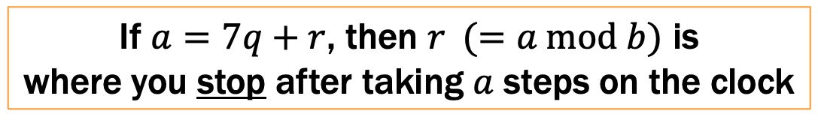
Arithmetic on a Clock
0
6
1
2 + 3 = 5
5
2
4
3
0
6
1
23 = 3 ∙ 7 + 2
5
2
4
3
If $a=7q+r$, then $r (=a \text{mod} b)$ is
where you stop after taking $a$ steps on the clock

Slide 46
Arithmetic, mod 7
(a + b) mod 7
(a × b) mod 7
0
6
1
5
2
4
3
+ | 0 | 1 | 2 | 3 | 4 | 5 | 6
0 | 0 | 1 | 2 | 3 | 4 | 5 | 6
1 | 1 | 2 | 3 | 4 | 5 | 6 | 0
2 | 2 | 3 | 4 | 5 | 6 | 0 | 1
3 | 3 | 4 | 5 | 6 | 0 | 1 | 2
4 | 4 | 5 | 6 | 0 | 1 | 2 | 3
5 | 5 | 6 | 0 | 1 | 2 | 3 | 4
6 | 6 | 0 | 1 | 2 | 3 | 4 | 5
X | 0 | 1 | 2 | 3 | 4 | 5 | 6
0 | 0 | 0 | 0 | 0 | 0 | 0 | 0
1 | 0 | 1 | 2 | 3 | 4 | 5 | 6
2 | 0 | 2 | 4 | 6 | 1 | 3 | 5
3 | 0 | 3 | 6 | 2 | 5 | 1 | 4
4 | 0 | 4 | 1 | 5 | 2 | 6 | 3
5 | 0 | 5 | 3 | 1 | 6 | 4 | 2
6 | 0 | 6 | 5 | 4 | 3 | 2 | 1
Notes:
5 = 0 * 7 + 5
6 = 0 * 7 + 6
7 = 1 * 7 + 0

Slide 47
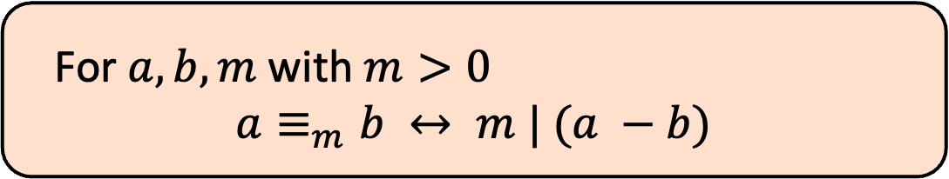
Modular Arithmetic
Domain of Discourse
Integers
Definition: “a is congruent to b modulo m”
For $a, b, m$ with $m>0$
$$a≡_{m}b ↔ m | (a −b)$$
New notion of “sameness” that will help us understand modular arithmetic

Slide 48
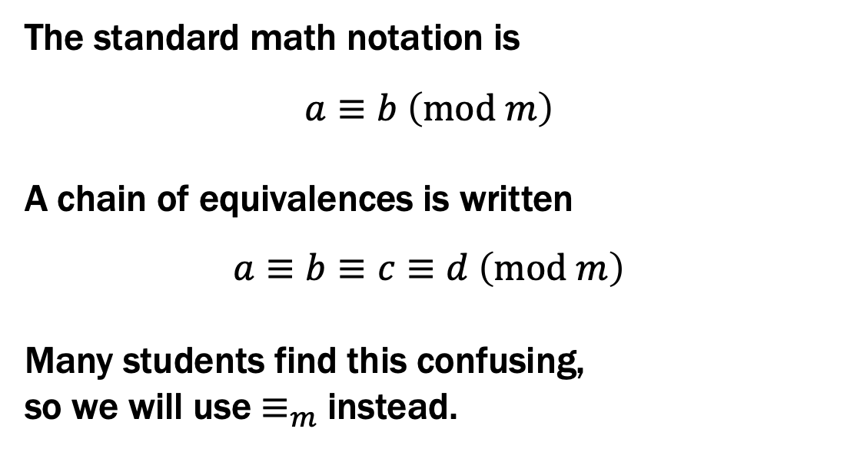
Modular Arithmetic
Domain of Discourse
Integers
Definition: “a is congruent to b modulo m”
For $a, b, m$ with $m>0$
$$a≡_{m}b ↔ m | (a −b)$$
The standard math notation is
$$a≡b \left(mod m\right)$$
A chain of equivalences is written
$$a≡b≡c≡d \left(mod m\right)$$
Many students find this confusing,
so we will use $≡_{m}$ instead.

Slide 49
Modular Arithmetic
Domain of Discourse
Integers
Definition: “a is congruent to b modulo m”
For $a, b, m$ with $m>0$
$$a≡_{m}b ↔ m | (a −b)$$
Check Your Understanding. What do each of these mean?
When are they true?
x ≡₂ 0
-1 ≡₅ 19
y ≡₇ 2
This statement is the same as saying “x is even”; so, any x that is even (including negative even numbers) will work.
This statement is true. 19 - (-1) = 20 which is divisible by 5
This statement is true for y in { ..., -12, -5, 2, 9, 16, ...}. In other words, all y of the form 2+7k for k an integer.

